Slide 1

Smart Doc Checker
Presented by:
Team HackOps

Slide 2
PROBLEM STATEMENT
Organizations such as companies, institutions, and clubs manage many documents policies, contracts, guidelines, and handbooks. Over time, contradictions emerge, such as mismatched deadlines, inconsistent attendance rules, or conflicting notice periods. These inconsistencies create confusion, inefficiencies, and risks of disputes or legal issues. Manual reconciliation is impractical due to document complexity and volume, while structural issues like siloed departments worsen the problem. If unresolved, contradictions can harm reputation, invite regulatory trouble, and cause strategic misalignment, as seen in cases like Boeing’s 737 MAX. This highlights the urgent need for automated systems to detect and manage contradictions efficiently.

Slide 3
OBJECTIVES
Develop a user-friendly portal for uploading multiple documents.
Automatically detect contradictions and overlapping statements between them.
Generate reports that clearly explain detected conflicts and suggest clarifications.
Integrate usage tracking and billing to charge per document analyzed and report generated.
Monitor external policy pages or documents to detect new conflicts in real-time.

Slide 4
EXISTING SYSTEM
Currently, most organizations depend heavily on manual or semi-automated document review processes. Compliance officers, legal teams, or administrators manually cross-check documents, which is time-consuming, inconsistent, and insufficient for large document sets or fast-changing environments. Some basic keyword search tools or text similarity methods are used, but these are limited to finding exact matches or overlapping content rather than semantic contradictions. Many existing AI applications focus on document classification, summarization, or sentiment analysis but fall short of identifying subtle or implicit conflicts that require deep contextual understanding.

Slide 5
PROPOSED SYSTEM
The Smart Doc Checker, is an AI-powered platform designed to automate the detection of contradictions across multiple organizational documents. It provides a user-friendly portal where users can upload 2-3 documents for analysis. The system leverages advanced natural language processing models to scan these documents, identify conflicting statements or overlapping clauses, and generate clear, detailed reports explaining each detected issue along with suggested clarifications. Additionally, the system incorporates Pathway integration to continuously monitor specified external documents or policy pages for updates, triggering automated contradiction re-evaluation in real-time to ensure ongoing accuracy and relevance.

Slide 6
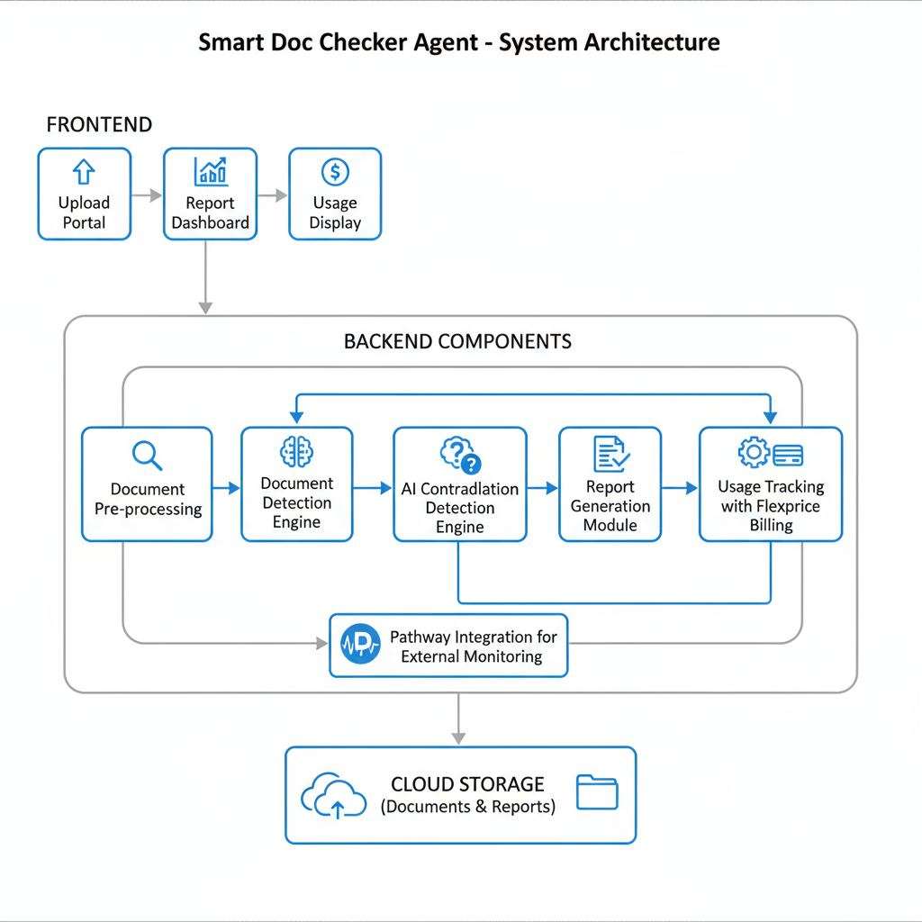
SYSTEM ARCHITECTURE

Slide 7
KEY FEATURES
Upload 2–3 documents at once for analysis.
Highlight contradictions with explanatory comments.
Automatically generate comprehensive conflict reports.
Display usage count for documents analyzed and reports generated.
Bill users transparently with flexible pricing per document and report.
Real-time monitoring of external documents/policies for new contradictions.

Slide 8
TOOLS USED
Natural Language Processing models (e.g., Transformer-based LLMs).
Web framework for frontend and backend (such as React for UI, Flask/Django for backend).
Flexprice API for billing and usage tracking.
Pathway API for external document update monitoring.
Cloud storage solutions for document and report persistence.

Slide 9
USE CASES
Corporate Compliance: Avoid contradictory contract terms and policy errors to reduce legal risk.
Educational Institutions: Harmonize circulars, guidelines, and attendance policies preventing student confusion.
Startups & SMEs: Save time on manual document reviews, improving efficiency and decision-making.
Human Resources: Ensure consistency between employee handbooks and contracts to streamline onboarding.
Government & Public Sector: Monitor regulation documents to maintain compliance and transparency.

Slide 10
IMPACT
Reduces manual workload and human error.
Speeds up document validation cycles.
Improves clarity and governance in organizational documents.
Enables real-time conflict detection on policy changes.

Slide 11
FUTURE ENHANCEMENT
Expand support for more document formats (PDFs, scanned images, tables).
Incorporate deeper semantic understanding for nuanced contradictions.
Enable multilingual document processing for global users.
Integrate with enterprise workflow tools (e.g., SharePoint, Jira).
Add AI-powered suggestions and automated conflict resolution mechanisms.

Slide 12
CONCLUSION
The pervasive presence of contradictory information in organizational documents poses a significant risk to operational efficiency, legal compliance, strategic clarity, and reputation. Manual approaches are inadequate due to scale and complexity. The Smart Doc Checker offers a robust, scalable solution by leveraging advanced AI and NLP techniques to automatically identify, explain, and report document contradictions. Its integration with usage tracking and Flexprice billing creates transparency and commercial viability, while real-time monitoring via Pathway ensures that new conflicts are discovered without delay. Adopting such a system helps organizations reduce risk, save time, and foster coherent governance.

Slide 13
THANKYOU

